Slide 1
Deploy globally available application
Vladimir Stefanović
CSA @Superadmins
Microsoft Certified Trainer

Slide 2




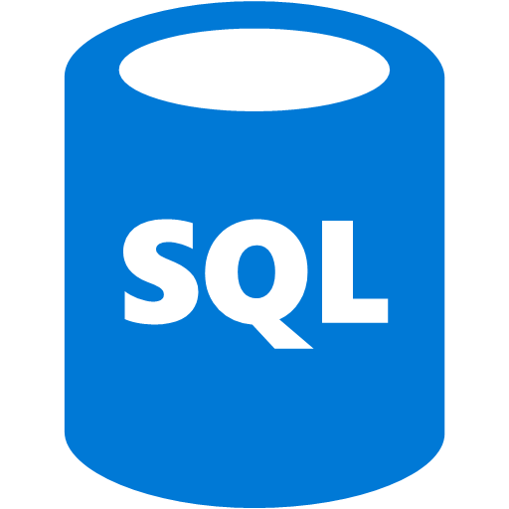
Deploy globally available application (Workshop)
Traffic Manager profile
Setting up a web application on the Azure platform today is no longer a "rocket science". If you decide to use Azure PaaS (App Service, Function App, Logic App ...), the process will be simplified, and your application can be available to users around the world in a short time. But .... If your application need to scalable and highly available, especially in the case of failure of the entire region, you need to implement additional services that will help you to achieve that goal.
Application Gateway
App Service
SQL Geo-replication

Slide 3

About trainer
Stefanovic Vladimir
Cloud Solution Architect, Lead Tech Trainer @SuperAdmins
MCT, MCSE, Azure Architect – Solution Expert
Conference speaker, book author
vladimir@superadmins.com
@Wladinho31

Slide 4
Agenda
Module 00 - Azure introduction
Module 01 - Deploy geo-replicated SQL database
Module 02 - Provision Web Apps and deploy applications
Module 03 - Provision and configure Application Gateway
Module 04 - Deploy and configure Traffic Manager profile

Slide 5
Module 00 - Azure introduction

Slide 6
Key concepts and terms
Cloud services have certain characteristics and considerations, such as:
High availability | Disaster recovery
Scalability | Global reach
Elasticity | Customer latency capabilities
Agility | Predictive cost considerations
Fault tolerance | Security
Notes:
Provide descriptions of each characteristic.
For more conceptual detail about cloud computing, open https://azure.microsoft.com/en-us/overview/what-is-cloud-computing/
There is also a term reference guide available at https://azure.microsoft.com/en-us/overview/cloud-computing-dictionary/

Slide 7
CapEx vs. OpEx
Capital Expenditure (CapEx): spend on physical infrastructure up front, deduct the expense from your tax bill
High upfront cost, value of investment reduces over time
Operational Expenditure (OpEx): spend on services or products as needed and get billed immediately. Deduct the expense from your tax bill in the same year
No upfront cost, pay-as-you use
Notes:
Today, organizations can sign up for a service from a cloud provider to get up and running. This enables them to begin selling or providing services to their customers more quickly, without the need for significant upfront costs
If your service is busy and you consume a lot of resources in a month, then you receive a large bill. If those services are minimal and don't use a lot of resources, then you will receive a smaller bill.
A business can still use the CapEx expenditure strategy if they want, but it is no longer a requirement that they do so.

Slide 8
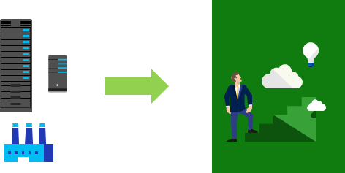
Consumption-based model
Users only pay for the resources they use
Notes:
The graphic represents physical infrastructure, which would have an associated cost to acquire it. The arrow indicates a transition to the cloud where there is no physical infrastructure. The user shows progression with their idea in the cloud, consuming only the resources that they need.
This consumption-based model brings with it many benefits, including:
No upfront costs
No need to purchase and manage costly infrastructure that they may or may not use to its fullest
The ability to pay for additional resources if and when they are needed
The ability to stop paying for resources that are no longer needed

Slide 9
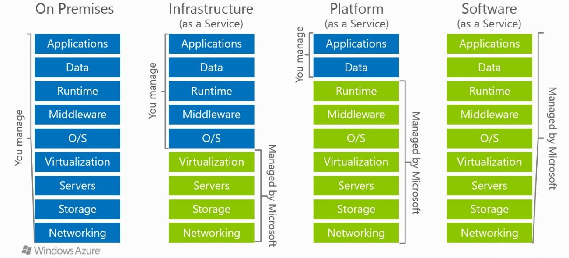
Management responsibilities
Notes:
It is important that users understand what they are responsible for when using cloud services, to ensure their workloads are managed correctly and don't suffer any down time.
IaaS requires the most user management of all the cloud services. The user is responsible for managing the operating systems, data, and applications.
PaaS requires less user management. The cloud provider manages the operating systems, and the user is responsible for the applications and data they run and store.
SaaS requires the least amount of management. The cloud provider is responsible for managing everything, and the end user just uses the software
There is a shared responsibility model for ensuring cloud workloads are run securely and in a well-managed way. Depending on the service you are using, the cloud provider is responsible for some aspects of the workload management, and the customer or end user is responsible for other aspects of the workload management, and in some cases both share a responsibility.

Slide 10
Module 01 - Deploy geo-replicated SQL database

Slide 11
Azure SQL database overview (1)
Azure SQL Database is a general-purpose relational database-as-a-service (DBaaS) based on the latest stable version of Microsoft
Azure SQL offers different deployment options
Single database with its own set of resources managed via a SQL Database server, like a contained databases in SQL Server
An elastic pool, which is a collection of databases with a shared set of resources managed via a SQL Database server
Managed instance, which is a collection of system and user databases with a shared set of resources. A managed instance is like an instance of the [Microsoft SQL Server database engine] offering shared resources for databases and additional instance-scoped features

Slide 12
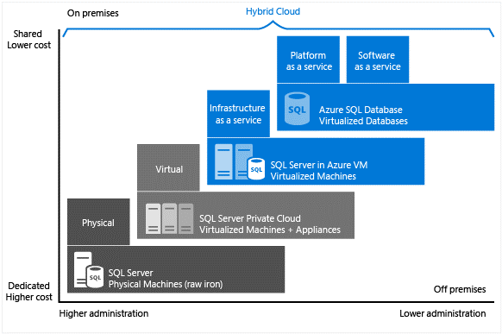
Azure SQL database overview (2)

Slide 13
Azure SQL features
Purchasing models
vCore - (vCore)-based purchasing model lets you independently scale compute and storage resources, match on-premises performance, and optimize price
DTU - This model is based on a bundled measure of compute, storage, and I/O resources
SQL Database serverless (preview) – Compute tier for single databases that automatically scales compute based on workload demand and bills for compute used per second
Geo-replication is just few clicks away from you
Database Backup is included by default and CANNOT be removed

Slide 14
Main goal of this workshop part
Traffic Manager profile
Create geo-replicated SQL database that will be responsible for storing application data
Primary copy of SQL database will be stored in one of European Azure regions
Secondary copy will be in one of US Azure regions
Application Gateway
App Service
SQL Geo-replication

Slide 15
Module 01 - Demo / Exercise

Slide 16
Module 02 - Provision Web Apps and deploy applications

Slide 17
Azure App Service overview
Azure App Service is a service for hosting web applications
Key features of App Service:
Multiple languages and frameworks
Global scale with high availability
Connections to SaaS platforms and on-premises data
Security and compliance
Application templates
Visual Studio integration
API and mobile features
Serverless code

Slide 18
App Service Plan
Define a set of compute resources for a web app to run
One or more apps can run in the same App Service plan
App Service plans define:
Region, number of virtual machine instances and instance size
Pricing plan
Shared compute - Free and Shared
Dedicated compute - The Basic, Standard, Premium, and PremiumV2 tiers run apps in the same plan in dedicated Azure VMs
Isolated - Dedicated Azure VMs on dedicated Azure Virtual Networks

Slide 19
Deployment methods
Support all common deployment methods
Zip, FTP, Visual Studio, GitHub & Bitbucket, Azure DevOps ...
Application can be deployed in more that one deployment slots
Requires Standard or Premium App Service plan
Ideal for deploying development, test and staging applications to the same service plan as a separated slot
Deployment slots are live apps with their own hostnames
Slots can be swapped that support Continious Deployment

Slide 20
Main goal of this workshop part
Traffic Manager profile
Create two App Service plans in different Azure regions
Configure CI/CD using GitHub
Application Gateway
App Service
SQL Geo-replication

Slide 21
Module 02 - Demo / Exercise

Slide 22
Module 03 - Provision and configure Application Gateway

Slide 23
Application Gateway (1)
Layer 7 web traffic load balancer, provides routing based on additional attributes of an HTTP request
Options provided are:
SSL termination
Autoscaling
Static VIP
URL-based routing
Multiple-site hosting
Custom error pages…

Slide 24
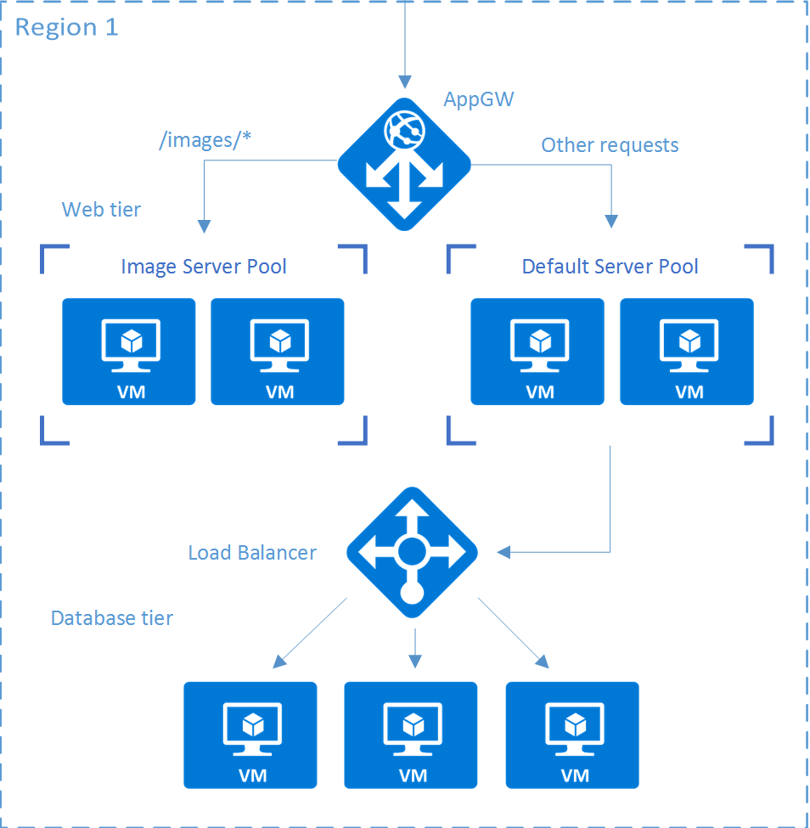
Application Gateway (2)

Slide 25
Main goal of this workshop part
Traffic Manager profile
Deploy and configure Application Gateway that will sits in front of App Service
Prepare application for globally available
Application Gateway
App Service
SQL Geo-replication

Slide 26
Module 03 - Demo / Exercise

Slide 27
Module 04 - Deploy and configure Traffic Manager profile

Slide 28
Traffic Manager overview (1)
Allows you to control distribution of user traffic to service endpoints around the world
Uses DNS to direct end-user requests to the most appropriate endpoint
Selects an endpoint based on the one of methods
Provides endpoint health checks and automatic endpoint failover

Slide 29
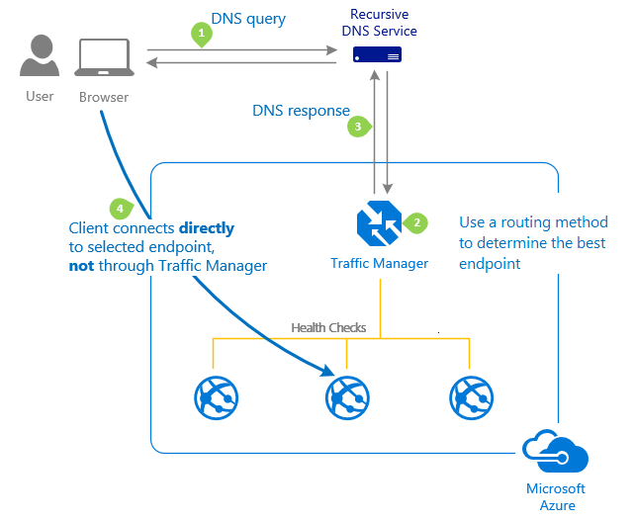
Traffic Manager overview (2)

Slide 30
Main goal of this workshop part
Traffic Manager profile
Deploy and configure Traffic Manager to balance traffic between applications in two different regions
Provide redundancy for your application if one of Azure region goes offline
Application Gateway
App Service
SQL Geo-replication

Slide 31
Module 04 - Demo / Exercise

Slide 32
Recap
Module 01 - Deploy geo-replicated SQL database
Module 02 - Provision Web Apps and deploy applications
Module 03 - Provision and configure Application Gateway
Module 04 - Deploy and configure Traffic Manager profile

Slide 33

Q & A

